Slide 1
Context Clues Review Jeopardy
Thursday, November 7th, 2013

Slide 2
Learning Targets from Week: Context Clues
Define the meaning of unknown words through context clues and the author’s use of comparison, contrast, definition, restatement, antonym/synonym and example.

Slide 3
Context Clues Jeopardy Rules
If you want to answer a question, you will need to raise your hand after the question has been stated.
You will be given either audio or chat privileges to give us your answer.
You must honestly keep track of your own points.
Try your best!
If you want to stay in the class connect after being divided into breakout rooms (2) and just want to watch (and review), that is fine. You do not have to play.

Slide 4
Context Clues Jeopardy
Context Clues: Definitions | Context Clue Practice 1 | What Kind of Context Clue? | Study Island: Context Clues Fun
100 | 100 | 100 | 100
200 | 200 | 200 | 200
300 | 300 | 300 | 300
400 | 400 | 400 | 400
500 | 500 | 500 | 500

Slide 5
Context Clues Definitions: 100
This type of context clue has a word or phrase with the same meaning.
(Example) The beach was covered with debris like paper and cans and the children picked up all the trash.
A.) Antonym Clue
B.) Restatement Clue
C.) Synonym Clue
D.) Example Clue
Notes:
C.

Slide 6
Context Clues Definitions: 200
What type of context clue is described here?
“The meaning of a word or phrase is explained immediately following its use.”
A.) An example clue.
B.) A restatement clue.
C.) A comparison clue.
D.) An explanation clue.

Slide 7
Context Clues Definitions: 300
What are context clues? Choose the best answer.
A.) Hints that help readers discover the meaning of unfamiliar words.
B.) Words being defined directly and clearly in the sentence in which they appear.
C.) A set of tools to help improve reading comprehension.
D.) I think that all the answer choices make sense.
Notes:
D.

Slide 8
Context Clues Definitions: 400
Select the type of context clue described below.
“A type of clue in which the meaning of a word is restated in another way.”
A.) Definition Clue.
B.) Restatement Clue.
C.) Example Clue.
D.) Explanation Clue.
Notes:
B.)

Slide 9
Context Clues Definitions: 500
Identify which context clue is being described below.
“Use of words or phrases that are the same as the underlined word.”
A.) Example Clue.
B.) Restatement Clue.
C.) Explanation Clue.
D.) Definition Clue.
Notes:
A.

Slide 10
Context Clue Practice 1: 100
Notes:
C.
Explanation: From this passage, the reader can tell that augmenting has to do with increasing or adding to something. If the committee increased the budget, they "would then be able to purchase the necessary supplies."

Slide 11
Context Clue Practice 1: 200
Notes:
D.
Explanation: The paragraph concludes with: "A NASA spokesperson said that the launch will still happen, but they are not sure when." If something is indefinite it is not definite. This answer choice makes the most sense in light of the last sentence.

Slide 12
Context Clue Practice 1: 300
Notes:
D.
Explanation: The word object has multiple meanings. It can mean "to complain" or "a thing." The correct answer and the sentence in the box both use the first definition of object.

Slide 13
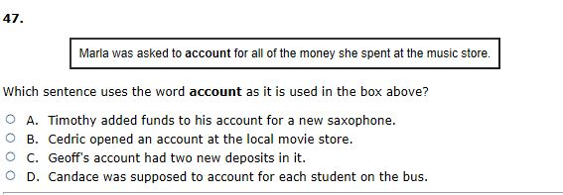
Context Clue Practice 1: 400
Notes:
D.
Explanation: The word account has multiple meanings. It can mean "a record of money paid out and money received" or "to give an explanation." The correct answer and the sentence in the box both use the second definition of account.

Slide 14
Context Clue Practice 1: 500
Notes:
A.
Explanation: The word console has multiple meanings. In the context of this sentence, console means "a piece of furniture."

Slide 15
What Kind of Context Clue? : 100
What kind of context clue could be used here to determine the meaning of the word noxious?
A.) A synonym clue
B.) A comparison clue
C.) An example clue
D.) None of the above
Notes:
C.

Slide 16
What Kind of Context Clue? : 200
Identify what type of context clue would be useful to determine the meaning of contusion.
A.) Definition/synonym clue
B.) Contrast clue
C.) Restatement clue
D.) An example clue
Notes:
A.

Slide 17
What Kind of Context Clue? : 300
Identify which kind of context clue could be used to identify the meaning of the word biographer based on its appearance in the sentence.
A.) A restatement clue
B.) An explanation clue
C.) An example clue
D.) None of the above
Notes:
B.

Slide 18
What Kind of Context Clue? : 400
Identify the specific type of context clue that may be useful in determining the meaning of squalid.
A.) Restatement clue
B.) An example clue
C.) Definition/synonym clue
D.) All of the above
Notes:
B.

Slide 19
What Kind of Context Clue? : 500
What type of context clue could be used to determine the meaning of the word calamity in this sentence?
A.) An explanation clue
B.) An example clue
C.) A synonym/definition clue
D.) A restatement clue
Notes:
D.

Slide 20
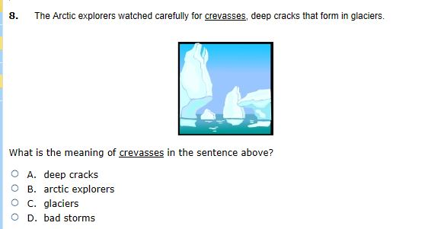
Study Island Context Clues Fun: 100
Notes:
A.

Slide 21
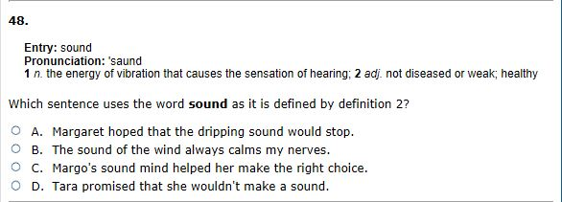
Study Island Context Clues Fun: 200
Notes:
C.

Slide 22
Study Island Context Clues Fun: 300
Notes:
C.
Explanation: The general idea of this selection provides the clues to the meaning of the word "lucid." Mr. Petrie is described as a teacher who makes difficult ideas easy to understand. It would make sense that his explanations would be clear, or lucid.

Slide 23
Study Island Context Clues Fun: 400
Notes:
C. You are looking to use the adjective form in this sentence of the word base.

Slide 24
Study Island Context Clues Fun: 500
Notes:
A.

